Slide 1
Theory as a method
Dave Cowan
University of Bristol

Slide 2
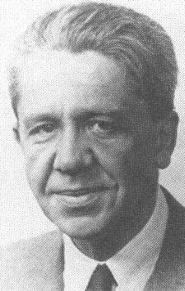
Getting a handle on “theory”
From science to social science, from doctrine to socio-legal studies
The perspective of a stranger: neither unreflective (the person on the street) nor trapped within the narrow vantage point of an academic specialism (the cartographer)
Simplification
Stereotyping
Hypotheses as inductive reasoning

Slide 3
Theory and method
Intertwining theory and method
Methods are more than part of our toolbox (“I do quals”)
Methods are located within theoretical positions
Ontology (what we believe to exist)
and epistemology (our theory of knowledge)
Methods cause silences
“Accuracy” and “validity”
Methods are never neutral (despite what we are told) but reflect our positionality
“… we are caught in a social process within which the most pressing question will always be the political one of deciding what counts as accurate, persuasive or authoritative”: Sarat, ‘Off to meet the wizard’

Slide 4
Theory/method: Socio-legal studies
From law and society to law in society: Mutually constitutive effects
From law to legality: “people may invoke and enact legality in ways neither approved nor acknowledged by the law”, Ewick & Silbey, The Common Place of Law
Translating things: Things are constantly in action
Power and size: eg The use of social media

Slide 5
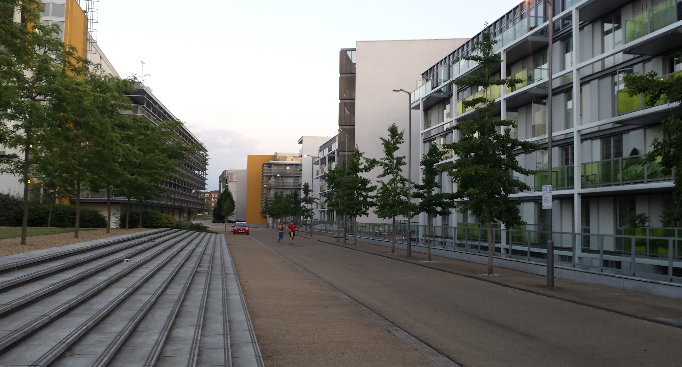
A case study: Property and the social or: what’s in a lease?

Slide 7
The strange case of the pot plants
Pot plants are a health and safety issue: 'You can't have those. They're a fire issue. If there is an emergency, that could obstruct the emergency services, or they could be a hazard to other people.’
[T]he lower floors from here are tenants; the upper floors are shared owners. One of the differences between the floors is the shared owners have more of that kind of … decoration and sort of personalisation, a sense of making it a nice environment. Because we've all got a stake in it and it's our flats, and maybe some of the social problems that exist in some of the other properties aren't - you don't get that with the shared owners. I'm talking, like, people out of prison, I'm talking about people with drug habits and so on and so forth. So looking after some nice flowers outside their front thing may not be their priority.

Slide 8
What am I? What are they?
I don't know what I am. I don't know what they think I am. I think I'm the owner, but I'm also partly a tenant, but I'm a tenant that they don't really care about. But they'll look after their real - their tenants, who don't own their properties. They'll go and do everything for them. I don't get anything.
We've had a couple of incidents with people in the social housing side that have been fly-tipping and causing a lot of rubbish. There was a Roma family over there but there were others as well that they have since been kicked out. But during that time … our service charge goes up because it's the general maintenance. Our proportion goes up and it went up by something like £100 each a year for an issue that is nothing to do with us.
Yes, that's the bit that like people own 100 per cent. So they, when they built those I think they're - this is according to someone, I think it's Dave, the guy that does some work for me. He said he's been over there and he said it's much higher spec. They've used better quality materials to build it. I don't think they're going to have any problem with their water just suddenly stopping, or their lift breaking. I think this one's slightly cheaper materials. So I think the fact that it's shared ownership.

Slide 9
Some concluding thoughts
Theory is method is theory
From law to legality – is legality over-emphasised? What is the salience of law?
How should we analyse our data? Are our observations valid and accurate?
It goes wrong … a lot

