Slide 1
Mixing methods to research policy and practice
Judith Masson
Professor of Socio-legal Studies
University of Bristol
Notes:
Knowing what you know
Getting started
Knowing what you (and others) want to know
Understanding and explaining why you want to know this

Slide 2
The research questions

Slide 3
What it says on the tin!

Slide 4
Reading the tin
Overlapping sources; competing aims
A little practice with big policy aims
By providing legal advice to parents, help families at risk of care proceedings address the causes of local authority concern and so divert cases from care proceedings
To ensure that cases which become subject to care proceedings are better prepared so that they can be concluded more quickly
The process was required but there were exceptions for cases needing a swift response; the process was not to delay required action

Slide 5
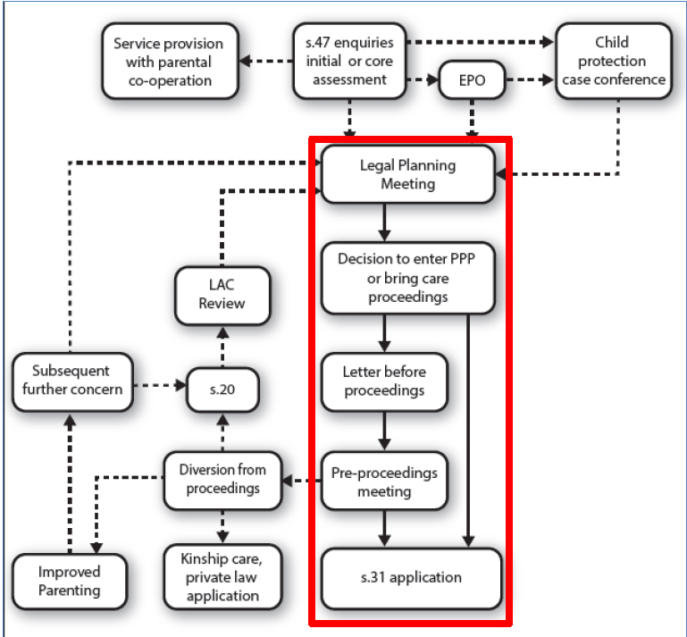
Notes:
Entry to formal pre-proceedings process is via Legal Planning Meeting, where decision is taken whether threshold met, and what the next step should be. The LAs in our study made substantial use of PPP- using it in almost all cases where was time to hold a meeting before proceedings were issued
Know that other LAs used it less, and there has been a decline in use of PPP. BUT PLO and new statutory Guidance re-emphasise importance of PPP
Only part of what is going on with families on the edge of care
Assessment as child in need or child in need of protection/ at risk of significant harm
child protection planning – Working Together 2013
Service provision – case work and other services, including universal services, sometimes s.20 accommodation

Slide 6
Research Questions
1. What is the relationship between the use and timing of pre-proceedings process and applications for care proceedings?
2. What are the characteristics of cases and interactions which result in (or are diverted from) care proceedings?
3. How do local authorities arrange ‘pre-proceedings meetings’, and do these arrangements provide parents with an opportunity to engage in constructive negotiation about their child’s protection?
4. How do social workers, social work managers and local authority lawyers define and manage their respective roles in ‘pre-proceedings meetings’?
5. How do solicitors and others acting for parents perceive and perform their role in ‘pre-proceedings meetings’?
6. Do parents feel that the ‘pre-proceedings meeting’ enables them to influence decisions about their children’s care?
7. To what extent are meetings successful in identifying and achieving alternatives to care proceedings or proceedings which are uncontested?
Notes:
When?
How?
Who with?
Who gets diverted? Who goes to court ?
Do parents feel they have a say

Slide 7
Does it?

Slide 8
Testing the product
Quantitative methods
Using LA and Court files for
Comparisons between
LAs
Courts
Cases
Comparisons of
Timing
Diversion
Duration
Sample 200+ cases; 6 LAs
Qualitative methods
Observations of meetings
Participation
Interaction
Outcome
Interviews
Social workers/ managers
LA lawyers
Parents’ lawyers
Parents
Follow up of observed cases
Sample 6 LAs at least 30 meetings

Slide 9
Putting it all together
Notes:
Key constraints meetings held at relatively short notice, frequently re-arranged; organised by various different people, who couldn’t be expected to inform researchers.
Solution to be there is being there.
Consent to attendance: professional consent easily arranged as part of access agreement with LAs but what about parents? Risk that letter sent from researchers would be confused with letter from LA and parents not attend meeting because they didn’t want to be observed.
Letters about research would be an additional task for SW because no agreement to disclose addresses.
Solution to consult inform lawyers of research, contact lawyers where identified to establish whether they had concerns, and to seek consent from parents at meeting.
Collected contact details to arrange follow up interview with parents but found it generally better to fix appointment directly after meeting if there was time.

Slide 10
Findings
LAs made different use of the process: types of case, timing, extent
Mothers more likely to be invited, to attend and to get lawyer than fathers
Process did divert cases from proceedings
Use of process delayed some court applications and did not make proceedings quicker
Judges took no account of work before proceedings
SW and managers generally positive but use of process declined
Parents’ lawyers positive
Parents quite positive and some responded positively to LA demands
Notes:
Different methods enabled us to answer different research questions or to answer the same questions in different ways

Slide 11
Key Insight; the power of the silent solicitor
... you know that everyone in the room is against you – which they are, that’s why you’re there – and when you’ve got your solicitor with you, you know they’re the only person who’s one 100% backing you up, so it helps you
...I am happy the solicitor is involved ... because before I was scared, I didn’t know what to do with them, I was just getting bullied – like gangs in school… but now your big brother is in school, you got confidence and that’s my solicitor. So I feel that, yeah, I feel all right now...

Slide 12
ESRC RES -062-2226
Masson, Dickens, Bader and Young (2013) Partnership by law? The pre-proceedings process for families on the edge of care proceedings, School of Law University of Bristol and Centre for Research on Children and Families UEA
http://www.bristol.ac.uk/law/research/researchpublications/2013/partnershipbylaw.pdf
Judith.Masson@bristol.ac.uk

