Slide 1
Mapping reconciliation in transitional criminal justice: a corpus linguistic approach
Sigrun Valderhaug Larsen

Slide 2
Introduction
Transitional justice:
the measures applied by successor regimes in addressing past human rights abuses
trials, truth commissions, amnesties, purges, lustration
Peace/truth versus justice
Why reconciliation?
Notes:
Transitional justice:
Characteristic of justice processes in post-conflict and post-dictatorial states is a heightened degree of politicisation of the law associated with particular rule of law challenges and compromises.
Invites the application of interdisciplinary approaches to the study of transitional justice processes.
Peace/truth versus justice:
In the literature however, criminal justice responses to past atrocities and reconciliation are often framed in dichotomous terms. There are important limitations linked to establishing individual criminal liability in response to human rights abuses committed in a collective or structural manner. In the wake of widespread human rights abuses, the criminal trial’s focus on one individual case at a time combined with strict evidentiary and procedural rules may fall short of adequately capturing complex patterns of violence and suffering. This in turn could contribute to arbitrary scapegoating and victimisation that perpetuate societal divides instead of promoting reconciliation and lasting peace. Reconciliatory processes are therefore more frequently associated with restorative approaches than criminal justice, and traditional criminal justice responses such as prosecutions, trials and punishment have even been argued to be incompatible with aims of reconciliation.
The question that this paper poses is what role reconciliation may nevertheless play in criminal justice responses to past abuses during times of transition.
Reconciliation:
Typically understood as an important factor in lasting peace
(Dayton Peace Agreement “Dedicated to peace, justice, tolerance, and reconciliation”)

Slide 3
Introduction
Corpus linguistics
A combination of quantitative and qualitative techniques to analyse large bodies of text (corpora)
Why is this relevant? A theory of language
Language plays a vital part in understanding how institutions are created, maintained and afforded power in societies
(Gee, 1999; Baker, 2006).
Notes:
When I propose a linguistic approach to legal research, this is founded in a particular theory of language in law. I argue that language is neither objective or purely informative. Instead I believe that language plays a vital part in understanding how social structures and institutions are created, maintained and afforded power and legitimacy in societies (Baker, P. Using Corpora in Discourse Analysis [London: Continuum, 2006]; Gee, J. P. An introduction to discourse analysis: theory and method [New York: Routledge, 1999]).
’Words spoken are the primary currency of court proceedings and although they themselves can withstand scrutiny and analysis, they are only fully revealed when they are shown to function in context.’ (Brennan, M. 'The discourse of denial: Cross-examining child victim witnesses' (1995) 23 Journal of Pragmatics 71, 74-75)

Slide 4
Methods and choices
Corpus consists of all the judgements by the ICTY
8.8 million words
Self-referencing
Focus on the word “reconciliation”
Notes:
Both Trial Chamber and Appeals Chamber judgements
The corpus is self-referencing in that the Tribunal creates precedence for itself and because the Appeals Chamber necessarily refers to the points in the Trial Chamber judgement that are being tried
Discourses may therefore be reinforced not so much by spontaneous occurrences as by conscious choices linked to legitimacy and institutional development
Future comparisons to other corpora important to draw more reliable conclusions
Chose to focus on the word “reconciliation” for the purpose of this paper to make the results more manageable
An expansion of the focus to include “reconcile” (lemma), and “reconciliatory” could reveal additional interesting results (however, please note that “reconciliatory” did not provide any hits in the ICTY corpus)

Slide 5
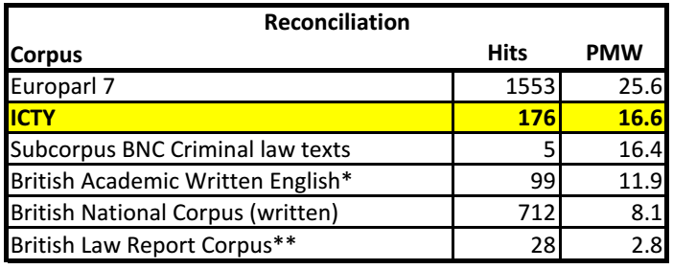
Concordance
Key numbers
176 hits
16.6 per million words (PMW)
Occurs in 37 out of 121 files (31%)
* 75% of hits in "transitional" contexts
** 57% related to financial language
Notes:
The Subcorpus BNC Criminal law texts consists of 305412 words in 8 texts
The Europarl 7 Corpus consists of the proceedings of the European Parliament from 1996 to the present
Notes to table:
* 75% of the hits occur in "transitional" contexts
** 57% related to financial language (reconciliation sheets, reconciliation of amounts of money, etc.)

Slide 6
Concordance
A simple sorting of the results show some tendencies of patterns
Verbs occurring frequently to the left of “reconciliation”
Nouns occurring frequently close to “reconciliation”
promote,
provide,
contribute
process,
remorse,
peace/peace-building,
truth,
guilty plea,
communities,
region,
Bosnia and Herzegovina,
former Yugoslavia

Slide 7
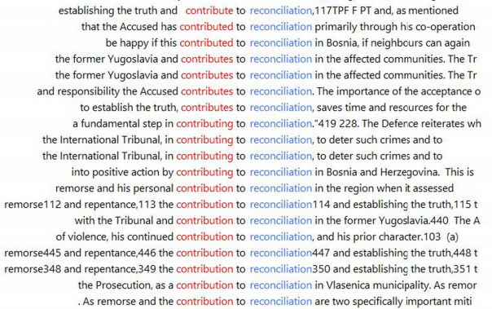
Concordance

Slide 8
Concordance

Slide 9
Concordance

Slide 10
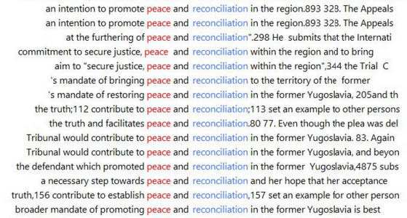
Concordance

Slide 11
Concordance

Slide 12
Concordance
So twelve words seem to be important
promote,
provide,
contribute,
process,
remorse,
peace/peace-building,
truth,
guilty plea,
communities,
region,
Bosnia and Herzegovina,
former Yugoslavia
Then the question is: So what?

Slide 13
Collocation
Collocation measures the statistical significance of words occurring near each other
I.e. is it more likely that a particular words occur close to “reconciliation” than we could expect from pure chance?
Use of two measures ensures strong collocation
Notes:
Ignored grammatical words
12 (15) words appear in the top 30 lexical collocates by both measures sorted by statistical strength
Both measures give 125 collocates
Approx. 55-60 are lexical words

Slide 14
Collocation
Once again twelve words seem to be important, eight of which overlap with the previous list
affected
communities
contribute
establishing
peace
process
promoting
region
remorse
restoring
step
truth
However, the question still is: So what?
Notes:
Ignored grammatical words
12 (15) words appear in the top 30 lexical collocates by both measures sorted by statistical strength
Both measures give 125 collocates
Approx. 80 are lexical words
8 of the words identified in the concordance search co-occur in final collocation list
“Contribute” includes:
contributes
contributing
contribution

Slide 15
Constructing reconciliation
The collocates can be categorised in three main categories:
Reconciliatory activity: What is being done to/with the
reconciliation?
Promoting, contributes, restoring, contribute, establishing
2. Reconciliatory subject: Who is the reconciliation directed
at/who is being affected by the reconciliation?
Affected communities, region
3. Co-occurring nouns
Remorse, truth, process, peace
Notes:
Three general categories of collocates

Slide 16
Constructing reconciliation
We can also expand this list by including semantically similar collocates with lower collocation strength
Notes:
Overarching structure can be used to explain most of the reconciliatory language
Explains 106 of 176 hits = 60%

Slide 17
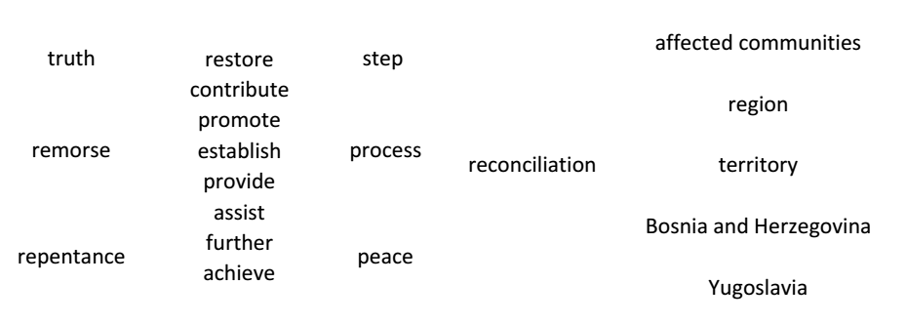
Constructing reconciliation
So far so good then..
The only problem now is that one question still remains: So what?
Notes:
Expanding by semantically similar words explains 112 of 176 hits = 64%

Slide 18
Discussion
Peace/truth versus justice
Dichotomisation in the literature
However, there is a salient discourse in the ICTY of the Tribunal’s role in contributing to truth, peace, and reconciliation
I.e. the Tribunal expresses a different understanding of the role of transitional criminal justice in peace-building than what is frequently premised in the literature

Slide 19
Discussion
A theory of language
Language plays a vital part in understanding how institutions are created, maintained and afforded power in societies
(Gee, 1999; Baker, 2006)
Transitional justice
(Re-)establishment of justice in fragile, traumatised and polarised societies
Highly politicised context
International tribunals = imposed justice?
Creation of legitimacy through reconciliatory discourses
Notes:
In this presentation my aim was to introduce some corpus linguistic methodological approaches to the analysis of ICTY judgements. I have briefly outlined some of the results of this approach in the form of discourses surrounding reconciliation in these legal texts. I have tried to point out some salient aspects of the ICTY’s reconciliatory discourses. Through this approach I was able to find linguistic patterns more easily than what would be feasible using merely in-depth legal analysis of the judgements. Yet, I was also able to examine closely the wider context of parts of the erupting patterns and could link the discourses to relevant parts of the Tribunal’s interpretation of the law. However, the black letter law analysis has certainly not been the focal point of this paper. So why then is this approach relevant to legal research? Does it even contribute to the field? My reason for proposing this approach as a useful contribution to legal research in general and transitional justice in particular, is based on the theory of language in law. I believe it highlights some aspects of how discourses can be constructed in a way that contribute to the legitimacy of legal institutions.

Slide 20
Thank you!

