Slide 1
Lessons from the Management of Public Interest Considerations in International Merger Control:
A Comparative Analysis
David Reader
PhD Researcher
Centre for Competition Policy and UEA Law School

Slide 2
?
Notes:
It’s interesting how ‘the consumer’ has come to play such a prominent role in modern competition policy.
- It’s analogous to being attributed a ‘label’ – we are each consumers and, as such, there are certain things we all attribute a great deal of value to as consumers…
- For example, (i) we want lower prices for our goods and services, (ii) we want better quality goods and services, or at least (iii) we (in the most part) want some degree of choice in the products and services available to us. Each of these things can be achieved under competitive markets (As far as I’m concerned, there’s no doubt about that).
But although we may each be consumers, that is not all we are defined by – or, at least, it shouldn’t be. We are each also members of the public and we care about things other than low prices, quality and choice. These things we see on the slide here are all things that have an impact on us, albeit in ways that are less easily observable than consumer welfare.

Slide 3
Research Questions
How do different states approach how to accommodate public interest criteria in merger control?
Why do they adopt a certain approach?
Are there relationships between these approaches and certain domestic variables?

Slide 4
Hypotheses
How a state chooses to accommodate public interest criteria depends on its socio-economic circumstances.
Politicians are likely to have a role in the decision-making process.
The role of public interest criteria in domestic merger control reflects how open a state is to foreign investment.

Slide 5
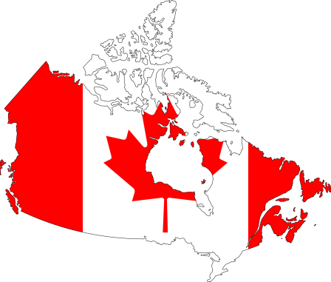
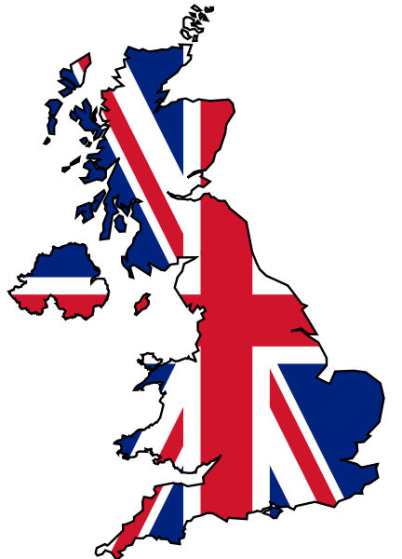
Which states consider PI criteria in merger control?
States which consider the public interest in their merger regimes:
States which do not consider the public interest within their regimes:
Australia
Canada
South Africa
United States
United Kingdom

Slide 6
Different States take different approaches…
Two key variables can be observed:
The procedural framework for accommodating public interest considerations; and
The individual/body which is tasked with deciding on the public interest element.

Slide 7
There are 4 ways of accommodating the public interest
Method 1
Avoid public interest criteria entirely!
Competition criteria

Slide 8
There are 4 ways of accommodating public interests
Method 2
Consider public interest criteria within the substantive test.
Competition
Public interest

Slide 9
There are 4 ways of accommodating public interests
Method 2
Consider public interest criteria within the substantive test.
Competition + ‘Substantial public interest grounds’
In particular:
Employment;
Black Economic Empowerment (BEE); and
International competitiveness of SA undertakings.
South Africa

Slide 10
There are 4 ways of accommodating public interests
Method 3
Assign specific/broad public interest ‘exceptions’ to the substantive test.
Competition criteria

Slide 11
There are 4 ways of accommodating public interests
Method 3
Assign specific/broad public interest ‘exceptions’ to the substantive test.
Competition criteria

Slide 12
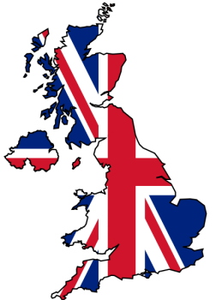
There are 4 ways of accommodating public interests
Method 3
Assign specific/broad public interest ‘exceptions’ to the substantive test.
Media plurality
Australia
Media plurality
Financial stability
National security
United Kingdom

Slide 13
There are 4 ways of accommodating public interests
Method 4
Allow sector-specific policies to run parallel to merger control.
Sector-specific policy

Slide 14
There are 4 ways of accommodating public interests
Method 4
Allow sector-specific policies to run parallel to merger control.
Financial services
Telecoms
Transport
Broadcasting
Canada
Banking
Telecoms
Transport
Media
Energy
United States

Slide 15
Comparison of domestic regimes
 | Australia | Canada | RSA | UK | USA
What is the substantive test? | ‘SLC’ | ‘Prevents or lessens competition’ | ‘SLC’ + ‘Public interest’ | ‘SLC’ | ‘SLC’
Method 2: Are PI considerations part of the substantive test? | No | No | Yes | No | No
Method 3: Are there PI exceptions to the substantive test? | Yes | No | No | Yes | No
Method 4: Are mergers subject to parallel sector-specific policy? | No | Yes | Yes | No | Yes
Who makes the public interest decision? | NCA + Sector regulator | -- | NCA | Politician | --

Slide 16
Comparison of domestic regimes
 | Australia | Canada | RSA | UK | USA
What is the substantive test? | ‘SLC’ | ‘Prevents or lessens competition’ | ‘SLC’ + ‘Public interest’ | ‘SLC’ | ‘SLC’
Method 2: Are PI considerations part of the substantive test? | No | No | Yes | No | No
Method 3: Are there PI exceptions to the substantive test? | Yes | No | No | Yes | No
Method 4: Are mergers subject to parallel sector-specific policy? | No | Yes | Yes | No | Yes
Who makes the public interest decision? | NCA + Sector regulator | Sector regulator | NCA | Politician | Government Agency (+ NCA)
NCA
+
Sector regulator
Government Agency
(+ NCA)
Sector regulator
NCA
Politician

Slide 17
Extending the data set: how many states?
Leading Practioners’ Handbook
Global Competition Review, Getting the Deal Through: Merger Control 2014

Slide 18
Extending the data set: how many states?
75 jurisdictions worldwide
73 domestic states
70 states with a substantive test

Slide 19
Dilemma
How do we ‘sort’ these 70 regimes according to how they accommodate public interest criteria?

Slide 20
Method 1: ‘Scoring’ approach
Potential Method 1
Treat ‘adherence to competition’ as a proxy for ‘avoiding public interest considerations’.
Domestic regimes with a pure competition-based approach to merger control score 1.
Domestic regimes that overlook competition and consider only public interest criteria score 0.

Slide 21
Method 1: ‘Scoring’ approach
Potential Method 1
Example
Competition-based test for mergers = 1.
If public interest is part of substantive test (M2)
Reduce Score by (-0.5) = 0.5.
If public interest is exception to substantive test (M3)
Reduce Score by (-0.25) = 0.75.
If merger is subject to sector-specific policy (M4)
Reduce Score by (-0.1) = 0.9.
If decision rests with a politician
Reduce Score by (-0.25) = 0.75.

Slide 22
Method 2: Segregating the data
Potential Method 2
Segregate methods into standalone categories in order to group domestic merger regimes.
Categories would consist of:
Method 1;
Method 2;
Methods 2 and 4;
Method 3;
Method 3 and 4.
All domestic regimes will fall into one of these sub-samples.

Slide 23
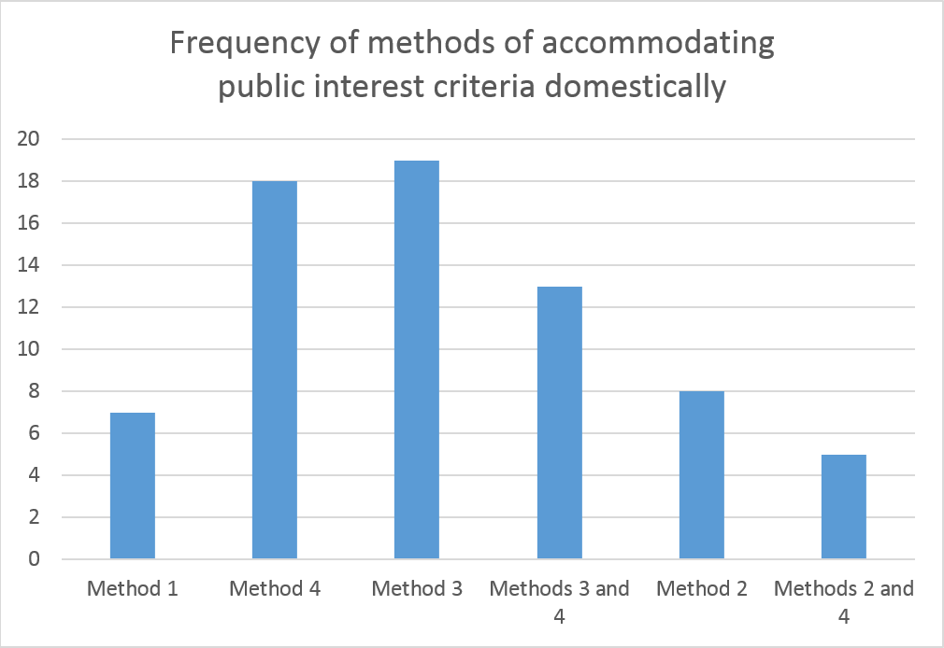
Method 2: Segregating the data
Potential Method 2
Least public interest
Most public interest

Slide 24
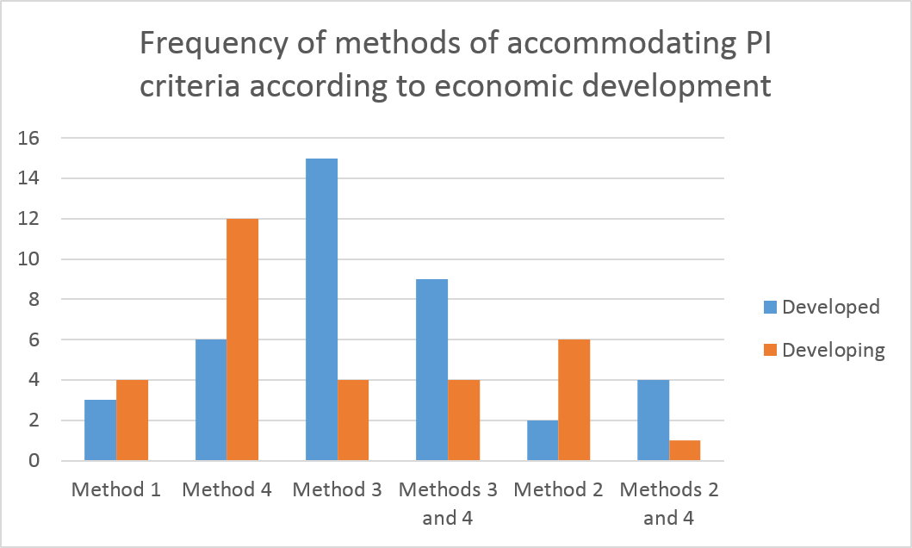
Preliminary observations on key variables
Economic development

Slide 25
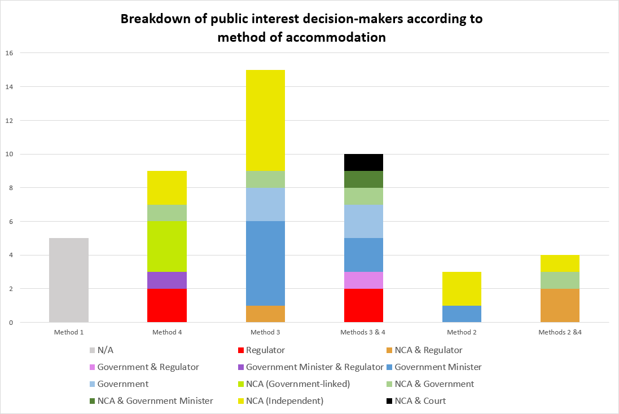
Preliminary observations on key variables
Decision-makers

Slide 26
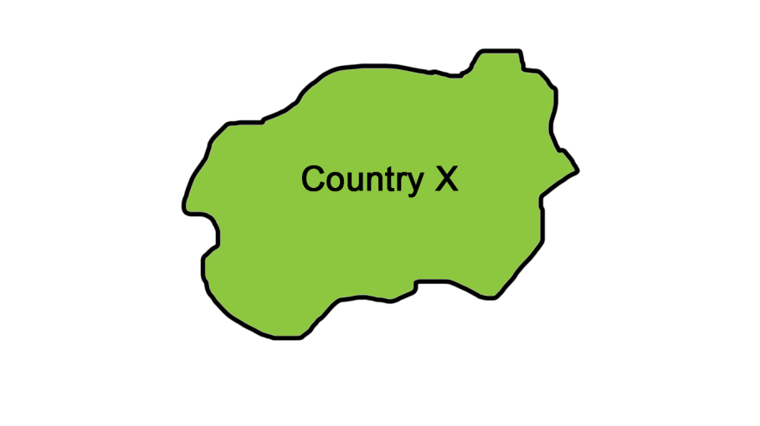
The special case of Foreign Investment…

Slide 27
The special case of Foreign Investment…
 | Australia | Canada | RSA | UK | USA
Is there a broad test for foreign investment? | ‘National interest’ | ‘Net benefit’ | (BEE) | (National security) | ‘National security’
Are there specific sectors protected by foreign investment policy? | Fin services Media Civil Aviation Telecoms Agriculture | -- | Banking Media | (Banking) (Media) | Banking Media Telecoms Transport Energy
Who enforces the foreign investment policy? | Politician | Politician | Politician | Politician | Government Agency (+ NCA)
*(_): Also applicable to mergers between domestic firms.

Slide 28
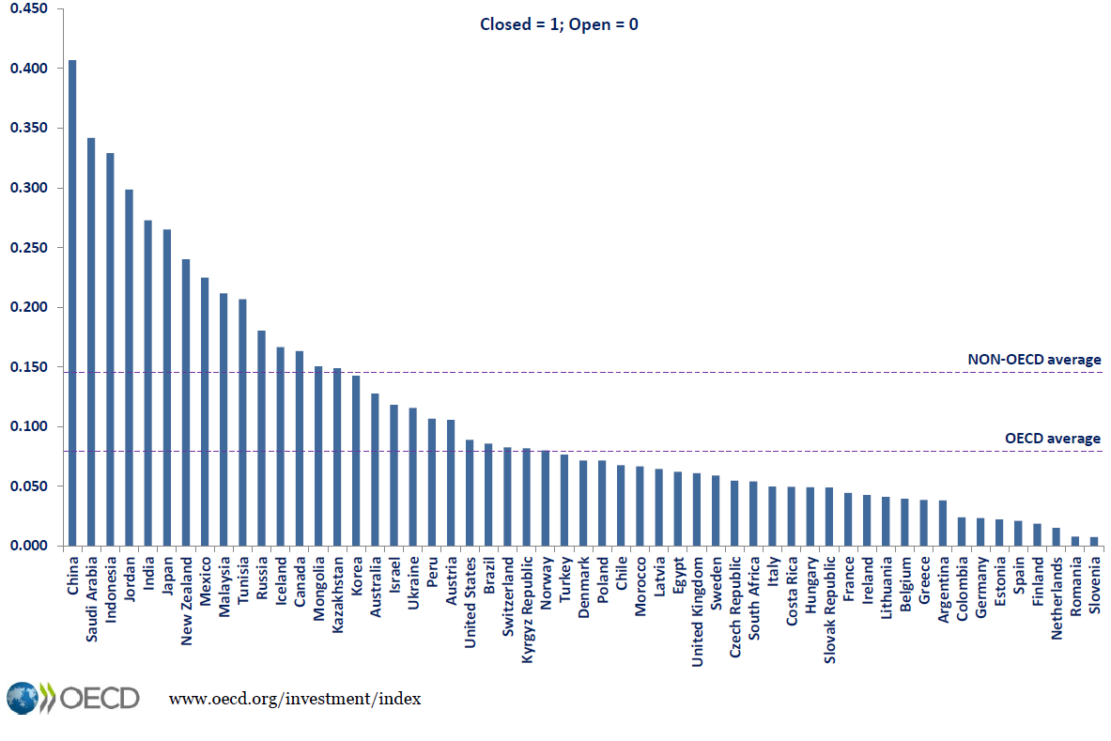
The restrictions imposed by foreign investment policy vary…
Canada
Australia
United States
United Kingdom
South Africa

Slide 29
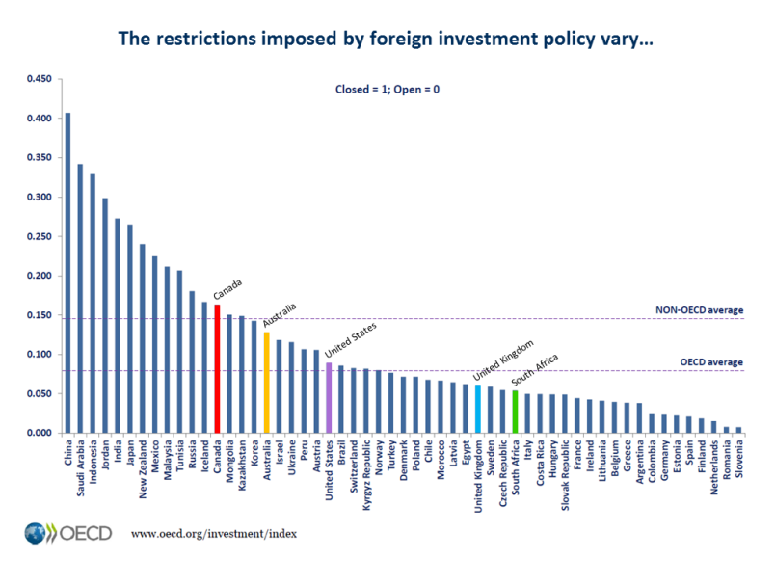
Assessing the ‘foreign investment’ variable
FDI Data (OECD)
Domestic Data (GCR)
‘Openness’ to Foreign Investment
Adherence to competition-based approach to mergers
‘Openness’ to considering public interest criteria in FDI
‘Openness’ to considering public interest criteria

Slide 30
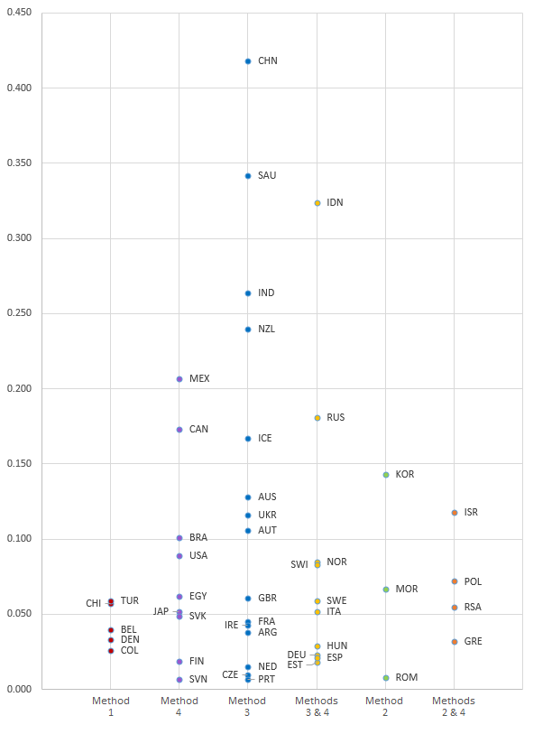
Assessing the ‘foreign investment’ variable
‘Openness’ to FDI
FDI Index score

Slide 31
Preliminary Observations
Procedural framework for accommodating PI criteria:
Competition remains the default standard.
Public interest considerations are marginalised, but to varying extents.
Sector-specific rules suggest certain States prefer to override competition, rather than balance it against public interests.
Both ‘overriding’ and ‘balancing’ raise legal certainty concerns.
Who decides on the public interest:
In domestic cases, the role of politicians is more restricted than first thought.
In foreign investment cases, the political role is vast.

Slide 32
Next steps
There is no ‘optimal’ way of accommodating public interests criteria
We must consider individual domestic variables
Democratic variables
Economic development
Rule of law (e.g. presence of political corruption)
Existence of a lobbying culture
Independence of courts
Common law or civil law jurisdiction
Cultural biases (i.e. preferences for/against competition and public interests)
Could/should this influence merger control reforms?

Slide 33
Thank you

